Slide 1
Time Series DataBase Comparison
InfluxDB
vs
TimescaleDB
September 24, 2024

Slide 2
overview
Introduction to Time-Series Databases
Installation & Setup Overview
Data Generation Process
Database Creation Steps
Data Loading and Measurements
Compression Rates Analysis
Query Generation Techniques
Query Execution Performance
Visual Performance Analysis
Numerical Performance Analysis
Final Observations and Conclusions

Slide 3
Introduction to Time-Series Databases
Introduction
Time-Series Databases (TSDBs)
TSDBs are designed for handling large volumes of time-stamped data, such as sensor data, stock prices, and IoT metrics.
High Write Rates: Efficiently manage large data ingestion.
Time-Based Queries: Optimized for fast retrieval of time-specific data, ideal for monitoring and analytics.
Efficient Storage: Use compression techniques to reduce storage needs.

Slide 4
Installation & Setup Overview
Setup
InfluxDB Installation Process
TimescaleDB Installation Process
InfluxDB is known for high ingestion rates and simplicity in handling time-series data.
Installation followed the official documentation provided on the InfluxDB website.
The database was successfully downloaded with all necessary configurations applied.
Environment was configured, dependencies verified, and system settings adjusted for optimal performance in local deployment. [1][2]
TimescaleDB is an extension of PostgreSQL designed for time-series data.
Installation followed guidelines outlined in the official TimescaleDB documentation.
Setup began by downloading and configuring the PostgreSQL database system.
TimescaleDB was installed as an extension of PostgreSQL, with necessary configurations applied for compatibility and efficiency. [3]

Slide 5
Data Generation Process
Data Generation
Using Time Series Benchmark Suite (TSBS)
Rationale for IoT Data Generation
Key Commands for Data Generation
The TSBS tool provides functionality for generating realistic time-series data and supports various formats compatible with different databases. By executing the appropriate TSBS commands, I was able to create data that could be efficiently inserted into both InfluxDB and TimescaleDB.
IoT-related use cases produce data that closely mirrors real-world conditions. This data often includes out-of-order, missing, or null entries, reflecting the complexities of actual IoT environments and making the datasets more representative.
The commands used for generating datasets include: tsbs_generate_data --use-case="iot" --seed=123 --scale=4000 --timestamp-start="2016-01-01T00:00:00Z" --timestamp-end="2016-01-04T00:00:00Z" --interval="10s" --format="timescaledb" | gzip > ./Data/timescaledb-data.gz.

Slide 6
Database Creation Steps
Database Creation
Create TimescaleDB DBs
Set Up InfluxDB Buckets
Configure Data Handling
Using pgAdmin4 app, initialize three databases: iot_data, iot_data_medium, and iot_data_small. Add the TimescaleDB extension to each with cascade enabled for seamless integration.
Create three data buckets in InfluxDB using CLI: iot_data, iot_data_medium, and iot_data_small. This structure allows efficient time-series data storage and querying.
Configure each database for time-series data, applying necessary settings for optimal performance. Verify TimescaleDB extension and InfluxDB setup for data types.
Three TimescaleDB databases.
(TimescaleDB extension added)
Three InfluxDB data buckets
Configured databases for performance

Slide 7
Data Loading and Measurements
Data Loading
Data Loading Commands
for TimescaleDB
Data Loading Commands
for InfluxDB
Time Measurements
uncompressed Data Size Measurements
tsbs_load_timescaledb --db-name=iot_data --host=localhost --user=postgres --pass=postgres --file=./Data/timescaledb-data
tsbs_load_influx --db-name=iot_data --file=./Data/influxdb-data --urls=http://localhost:8086
TimescaleDB loading times:
2122.373 sec (Full)
246.152 sec (Medium)
8.804 sec (Small)
InfluxDB loading times:
2100.321 sec (Full)
240.234 sec (Medium)
8.004 sec (Small).
For TimescaleDB:
Full (35 GB)
Medium (6 GB)
Small (294 MB)
For InfluxDB:
Full (43 GB)
Medium (10 GB)
Small (1 GB)

Slide 8
Compression Rates Analysis
Performance Analysis
Compression Rate Formula
Compression Rate = ((Uncompressed Data Size - Compressed Data Size) / Uncompressed Data Size) × 100.
TimescaleDB Compression Rates
Full Dataset: Uncompressed Size: 35 GB, Compressed Size: 26 GB, Compression Rate: 25.71%
Medium Dataset: Uncompressed Size: 6 GB, Compressed Size: 4.536 GB, Compression Rate: 24.40%
Small Dataset: Uncompressed Size: 294 MB, Compressed Size: 242 MB, Compression Rate: 17.69%
InfluxDB Compression Rates
Full Dataset: Uncompressed Size: 43 GB, Compressed Size: 26 GB, Compression Rate: 39.53%
Medium Dataset: Uncompressed Size: 10 GB, Compressed Size: 6.2 GB, Compression Rate: 38%
Small Dataset: Uncompressed Size: 1 GB, Compressed Size: 712 MB, Compression Rate: 30%.

Slide 9
Query Generation Techniques
Performance Evaluation
Overview of TSBS
The Time Series Benchmark Suite (TSBS) was utilized to generate queries for both InfluxDB and TimescaleDB. It supports various query formats for realistic time-series databases evaluation.
Types of Queries
The TSBS tool generates queries across multiple types:
Last Location (retrieving the most recent data point, a common requirement in IoT applications like asset tracking)
Long Driving Sessions (tests the system's ability to handle range queries over extended periods)
Average Load (assess the performance of aggregation queries)
Daily Activity (chosen because of the need for generating daily reports)
Breakdown Frequency (evaluates how well the database handles scanning large datasets for specific events)
Query Generation Commands
Commands include: TimescaleDB: `tsbs_generate_queries --use-case="iot" --scale=1000 --query-format="timescaledb" --type="last-loc”`. InfluxDB: `tsbs_generate_queries --use-case="iot" --scale=1000 --query-type="last-loc"`.

Slide 10
Query Execution Performance
Performance Analysis
TimescaleDB Query Execution
InfluxDB Query Execution
A Bash script [5] was designed to automate the execution of queries on TimescaleDB databases, evaluating performance across varying database sizes and query types.
The script specifies connection parameters like host, port, username, and password for interfacing with PostgreSQL.
It targets three databases: iot_data, iot_data_medium, and iot_data_small, executing multiple queries with different worker counts.
The execution process includes nested loops iterating over each database, query file, and worker count, logging progress and results for further analysis.
A similar Bash script [6] automates the execution of queries on InfluxDB databases, also targeting varying database sizes and query types.
The script requires connection parameters to interface with the InfluxDB instance, which is pre-configured.
It defines three target databases: iot_data_small, iot_data_medium, and iot_data, executing predefined queries with varying worker counts.
Results from executed queries are logged systematically for post-execution analysis, mirroring the TimescaleDB approach.

Slide 11
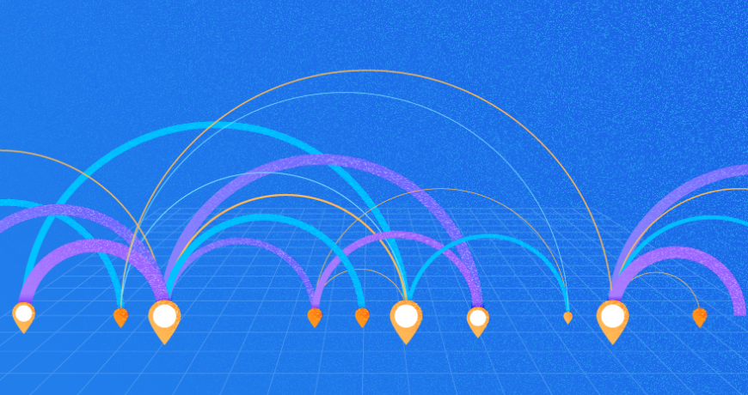
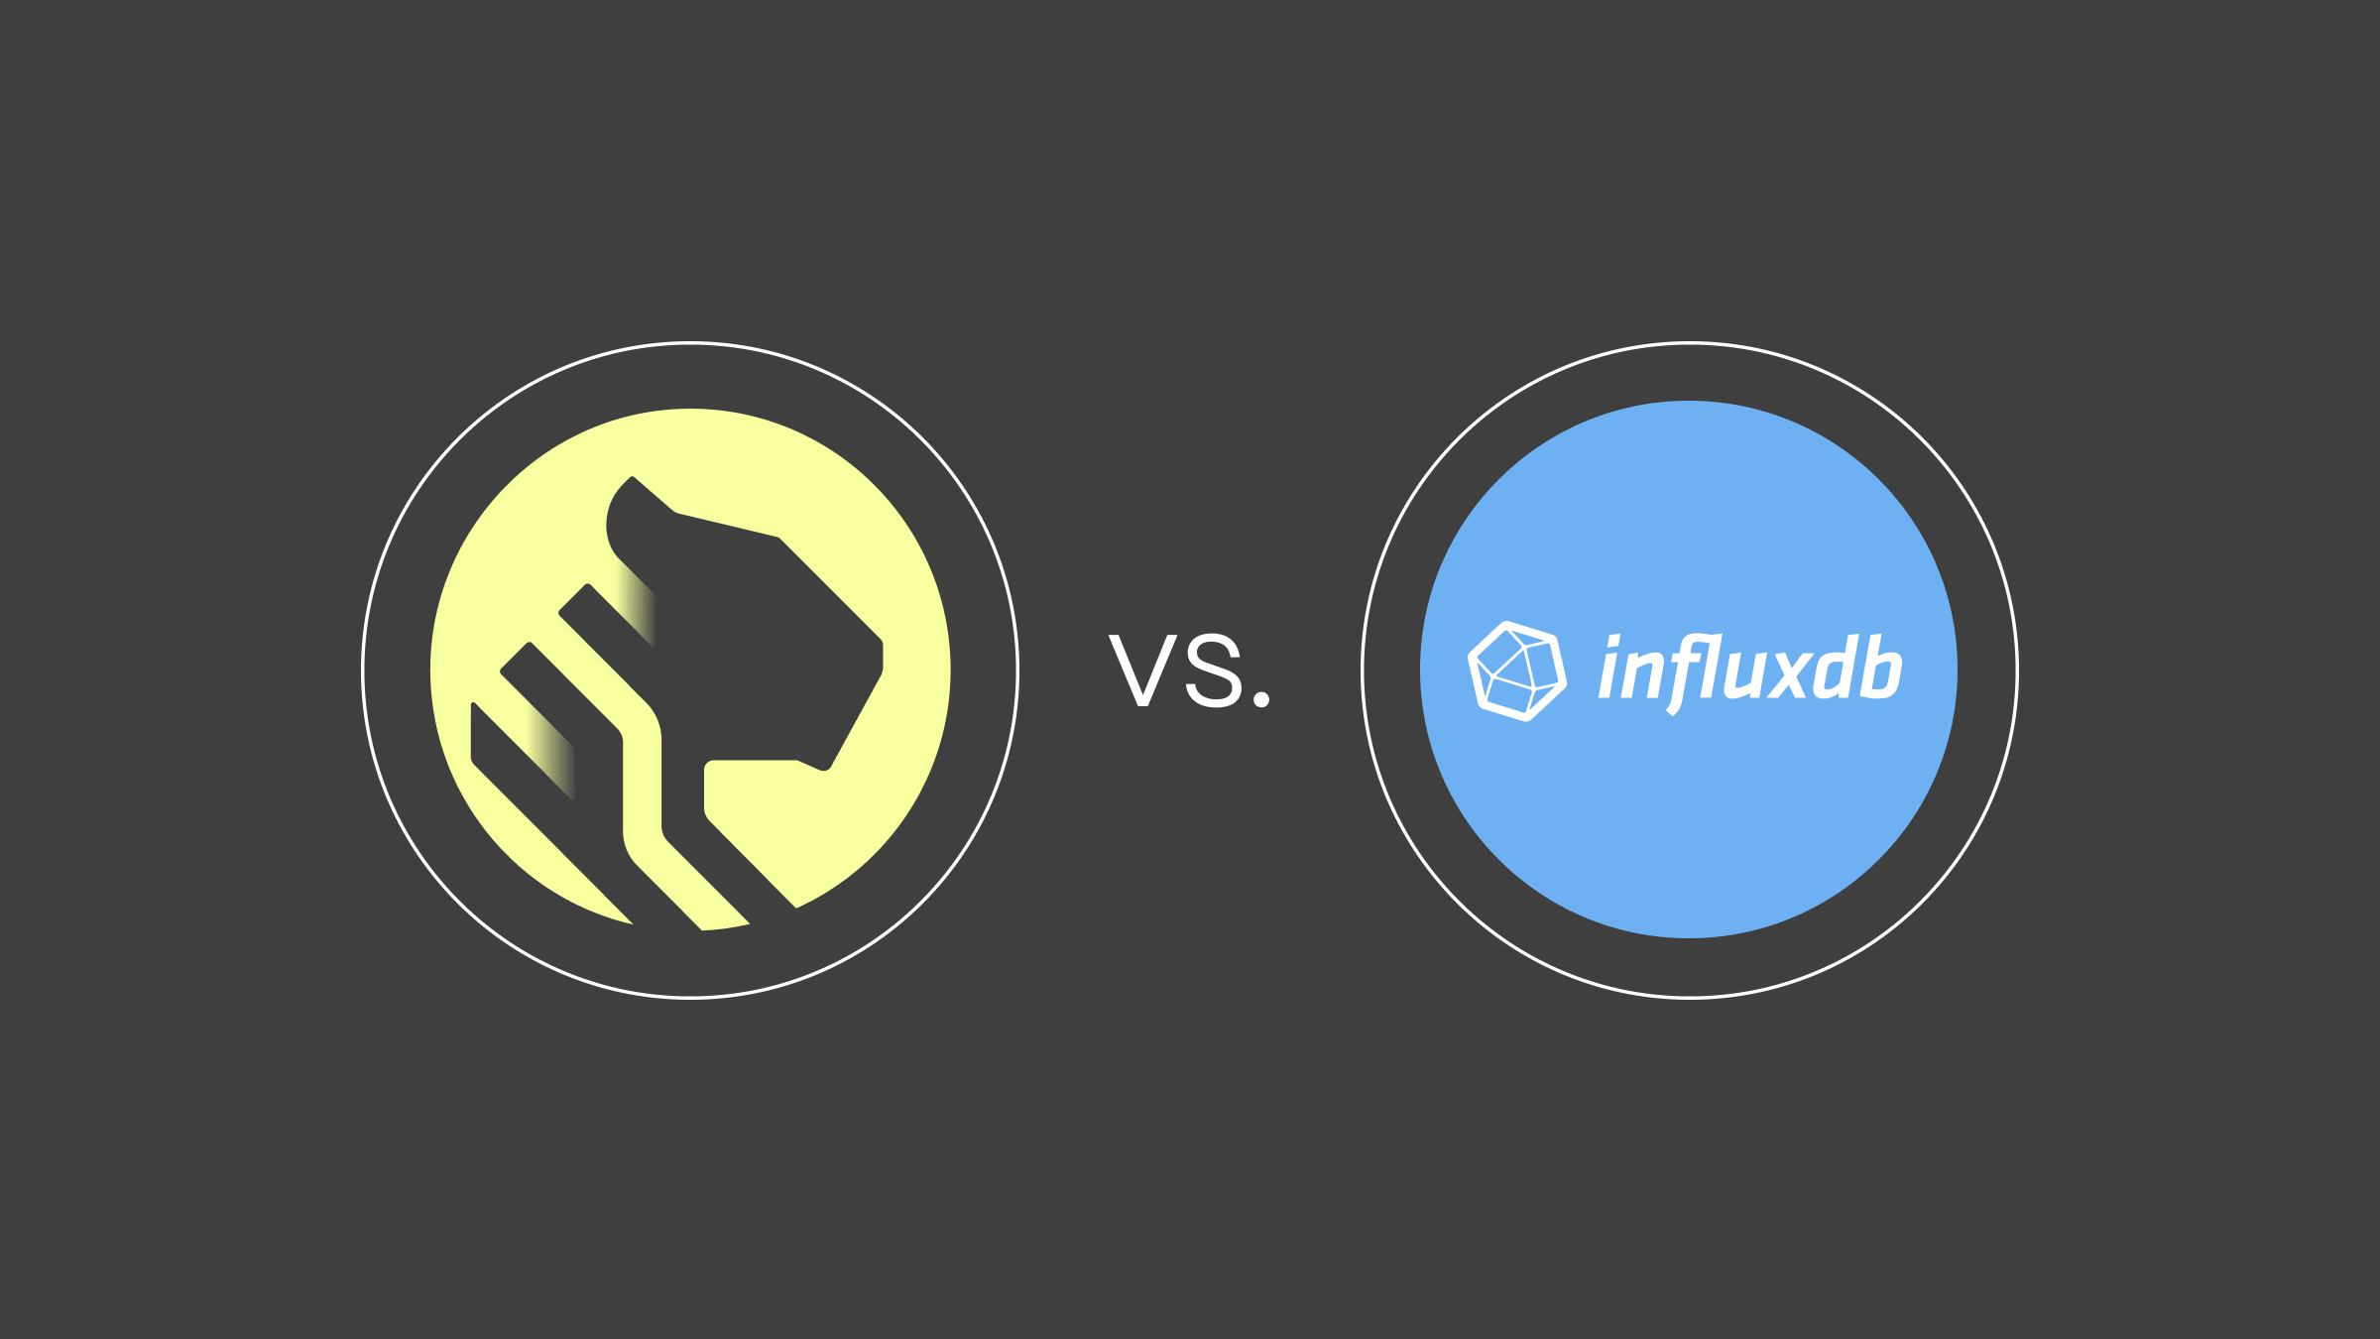
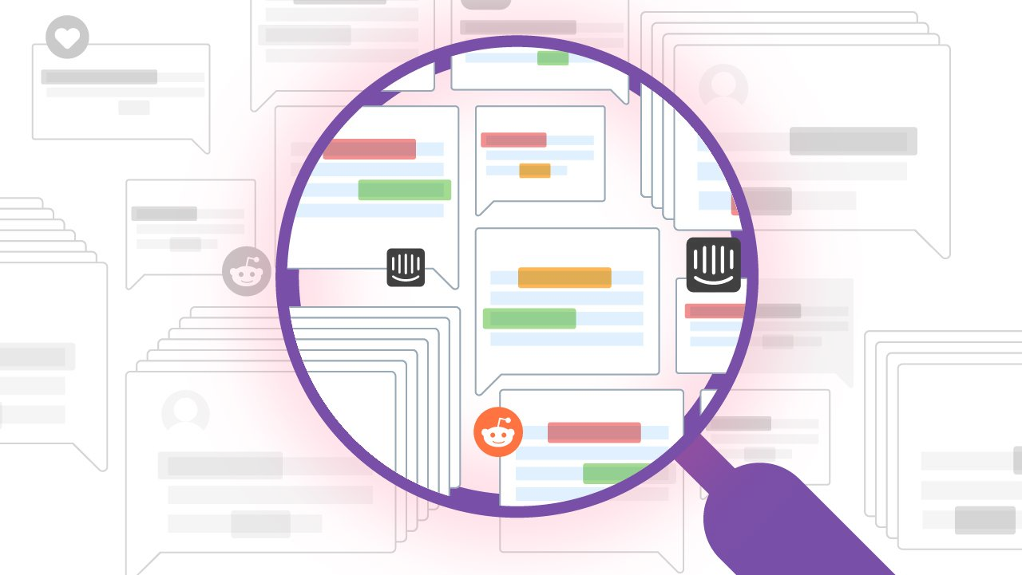
Visual Performance Analysis
Analysis
Performance Graphs
Graphs generated using a Python script [7] illustrate the performance metrics for each database and query type, enabling easy comparison of performance across varying dataset sizes.
Dataset Comparisons
The visual analysis encompasses full, medium, and small dataset comparisons, highlighting differences in query execution times and rates between InfluxDB and TimescaleDB.
Key Insights from Graphs
The graphs reveal trends such as InfluxDB generally offering faster query execution times across most query types, with improvements ranging from -0.94% to -9.77%.

Slide 12
Numerical Performance Analysis
Query Performance
Automation of Performance Comparison
Key Metrics Extracted
A Python script [8] automates the process of comparing the performance between TimescaleDB and InfluxDB based on result files generated from query tests.
The script extracts key performance metrics including overall query rate, minimum, median, mean, and maximum query times.
Performance Comparison Logic
Results Presentation
The script computes the difference in mean query time and overall query rate between TimescaleDB and InfluxDB, allowing for a direct comparison.
Results are printed to the console, showing details such as mean query times and overall query rates, with options to write results to a CSV file for further analysis.

Slide 13
Final Observations and Conclusions
Conclusions
InfluxDB consistently demonstrated faster mean query execution times across most query types, with improvements ranging from -0.94% to -9.77%.
In point queries (last-loc), InfluxDB slightly outperformed TimescaleDB, aligning with expectations due to its optimization for time-series point lookups.
For aggregation queries, the performance differences were minimal, indicating that both databases handle complex queries with similar efficiency.
Overall Query Rate differences were generally small, with InfluxDB sometimes showing slightly lower throughput, possibly due to its single-threaded nature for certain operations.
The performance benefits of InfluxDB were more pronounced at higher concurrency levels (8 and 16 workers), particularly for avg-load and breakdown-frequency queries.
TimescaleDB maintained relatively consistent throughput across different worker counts, showcasing its strength in handling concurrent workloads.

Slide 14
References
Appendix
"Install InfluxDB | InfluxDB OSS v2 Documentation," [Online]. Available: https://docs.influxdata.com/influxdb/v2/install/?t=Windows. [Accessed 2024].
"Time2 – TimescaleDB – Bash Script - 2024, gitHub repository.," [Online]. Available: https://github.com/ntua-el17840/Time2/blob/main/Scripts/run_tsbs_queries_timescaleDB.sh . [Accessed 2024].
[1]
[5]
"Set up InfluxDB | Get started with InfluxDB | InfluxDB OSS v2 Documentation," [Online]. Available: https://docs.influxdata.com/influxdb/v2/get-started/setup/. [Accessed 2024].
[2]
"Time2 – InfluxDB – Bash Script - 2024, gitHub repository.," [Online]. Available: https://github.com/ntua-el17840/Time2/blob/main/Scripts/run_tsbs_queries_infulxDB.sh . [Accessed 2024].
[6]
"Time2 – Visual Analysis – Python Script - 2024, gitHub repository.," [Online]. Available: https://github.com/ntua-el17840/Time2/blob/main/Scripts/generate_tsbs_graphs.py. [Accessed 2024].
"Timescale Documentation | Install TimescaleDB on Windows," [Online]. Available: https://docs.timescale.com/self-hosted/latest/install/installation-windows/. [Accessed 2024].
[7]
[3]
"Time2 – Numerical Analysis – Python Script - 2024, gitHub repository.," [Online]. Available: https://github.com/ntua-el17840/Time2/blob/main/Scripts/numerical_query_analysis.py . [Accessed 2024].
[8]
"PostgreSQL: Windows installers," [Online]. Available: https://www.postgresql.org/download/windows/. [Accessed 2024].
[4]

Slide 15
Thank you

